Slide 1
The Fluocell Image Analysis Software Package
Shaoying Lu
5/10/2013, Updated on 5/8/2017

Slide 2
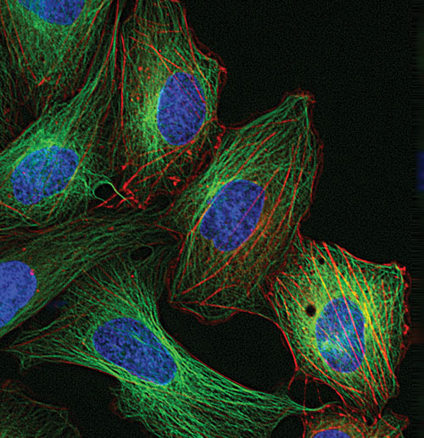
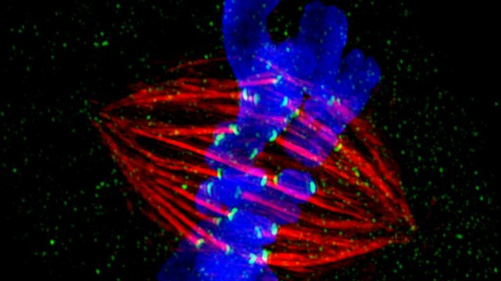
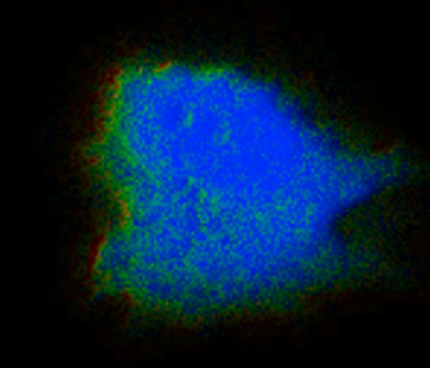
Live Cell Imaging Provides Tremendous Amount of Data

Slide 3
Why Automated Analysis?
Objective, Quantitative, and Large Scale
Reveals Non-obvious and Hidden Information
Systematic Understanding of Dynamic Images with spatial Information
Multi-channel and Multiplexing
Additional Advantages
Real Time quantification during Imaging
Available for Personal Computers.

Slide 4
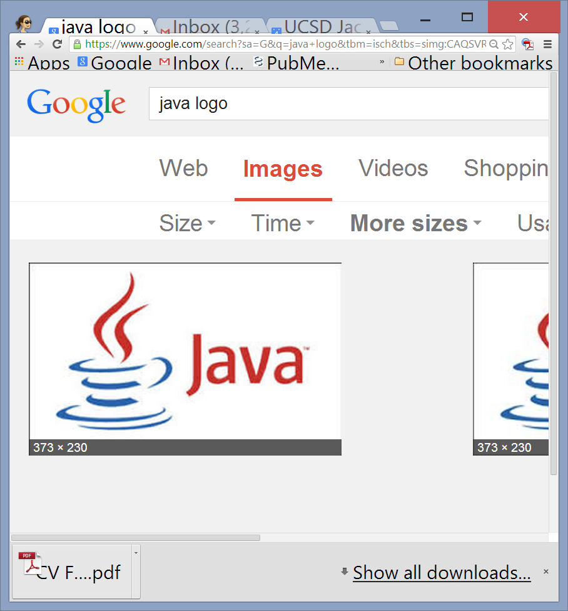
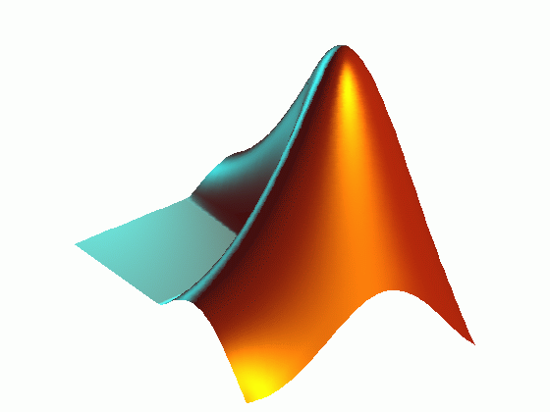
Fluocell Schematics
MATLAB
Image Data
Graphic User Interface
Visualize & Quantify
Object-Oriented
Modulated

Slide 5
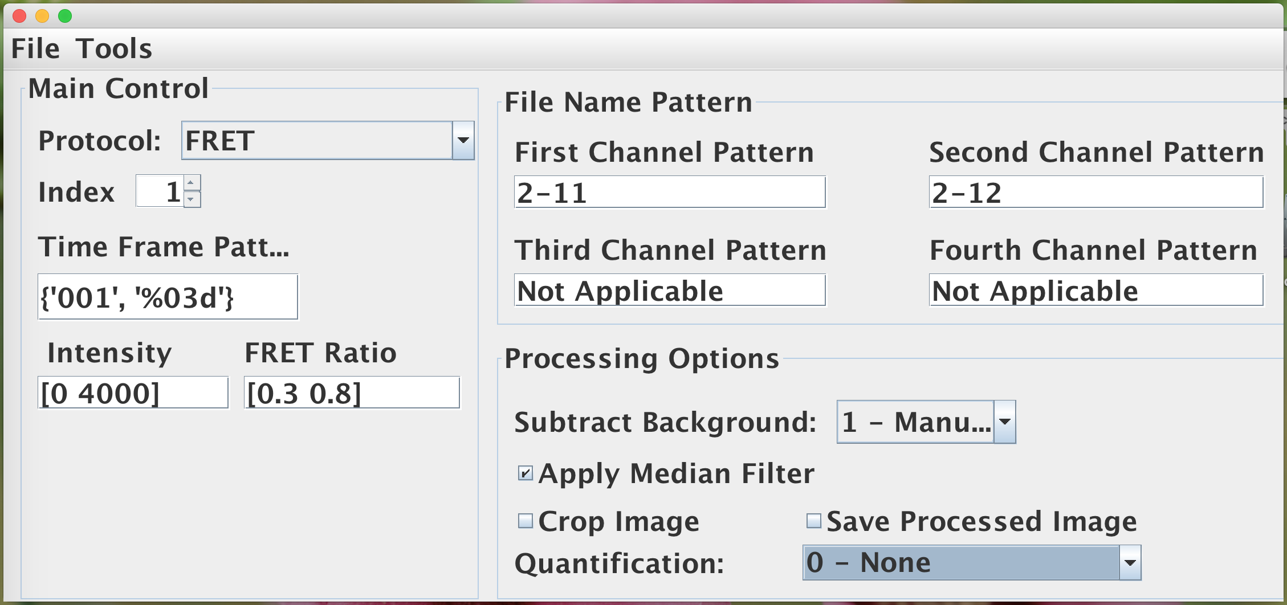
Visualize the ECFP/FRET Ratio Images

Slide 6
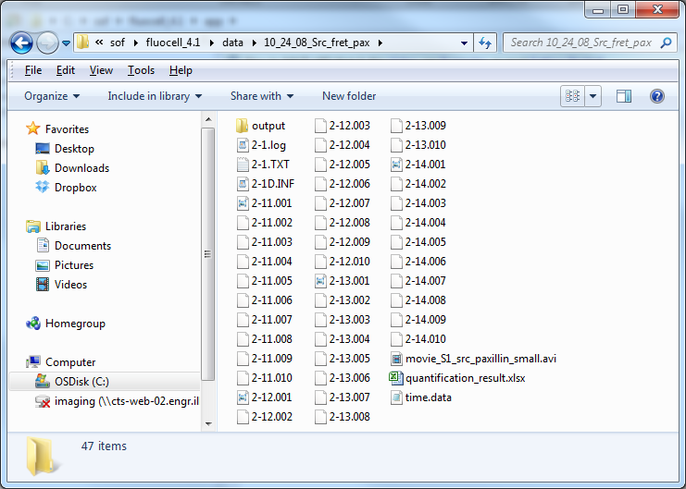

Slide 7
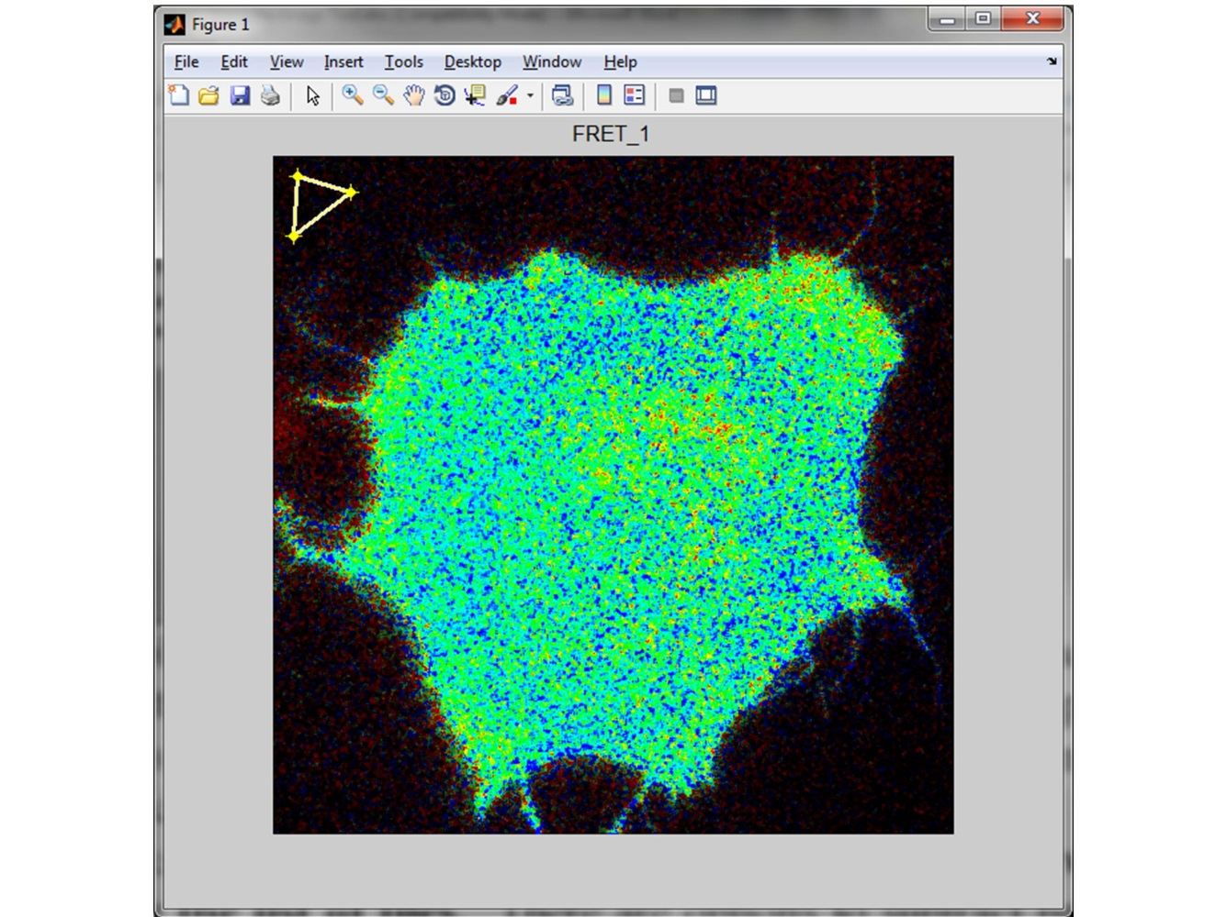
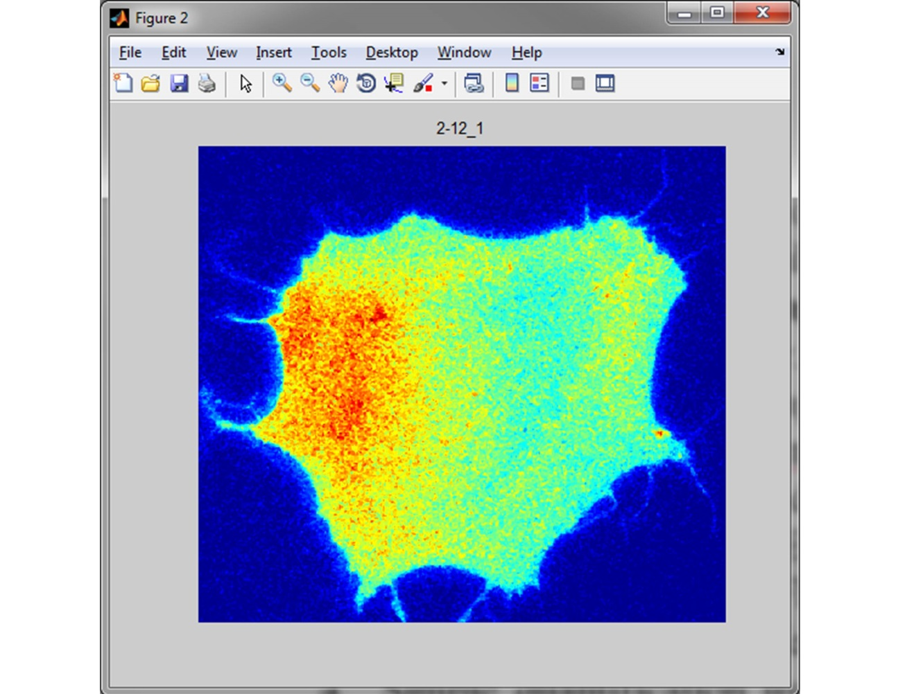

Slide 8
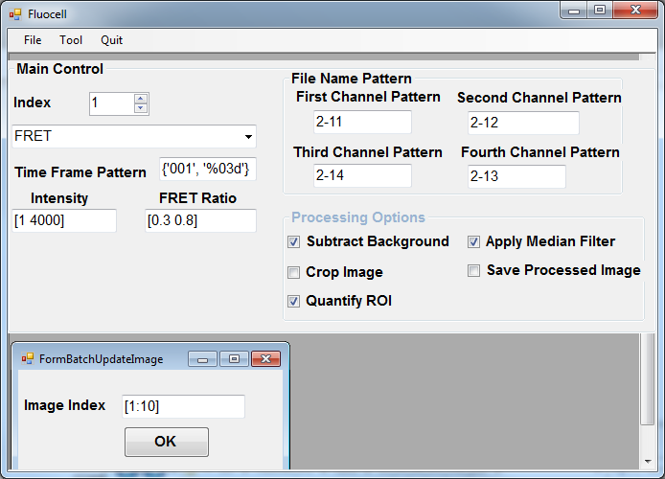
Quantification using regions of interest (ROIs)

Slide 9
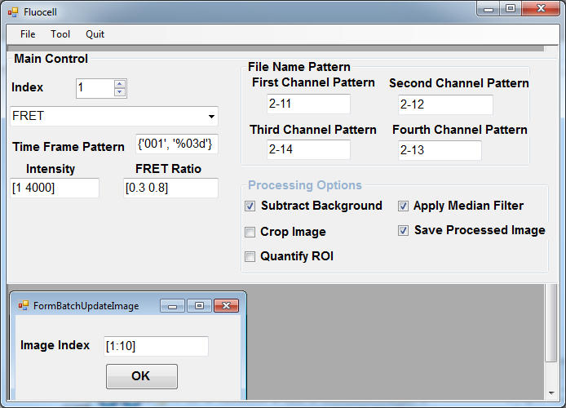
Make Movies

Slide 10
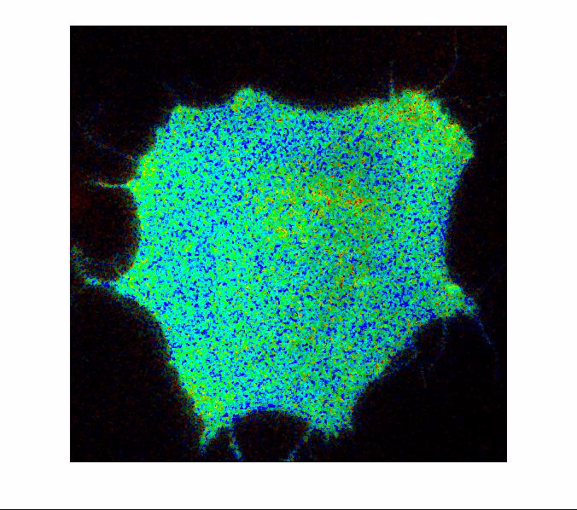

Slide 11
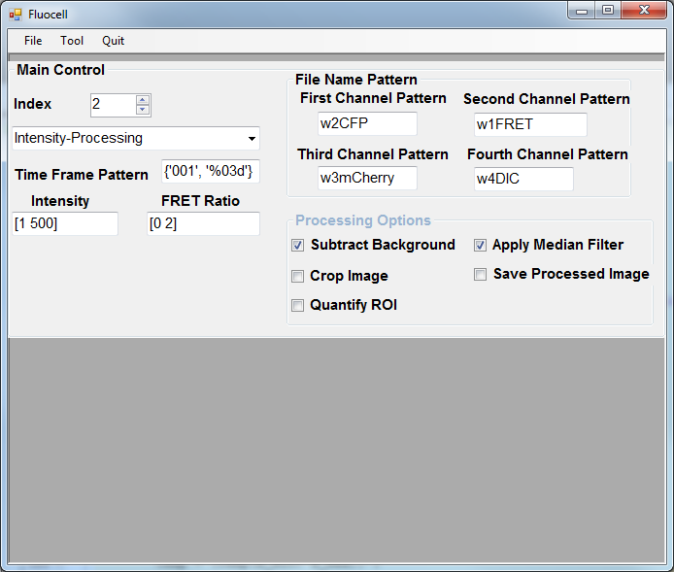
Polarity Analysis

Slide 12
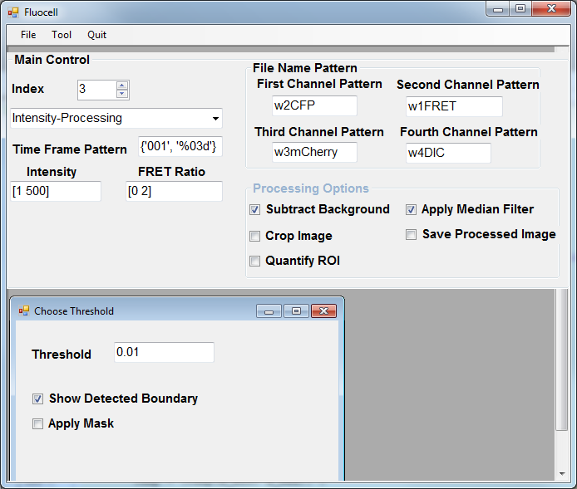
Decide the threshold for cell detection

Slide 13
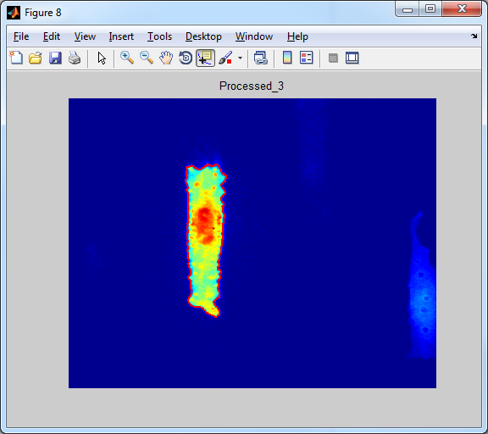

Slide 14
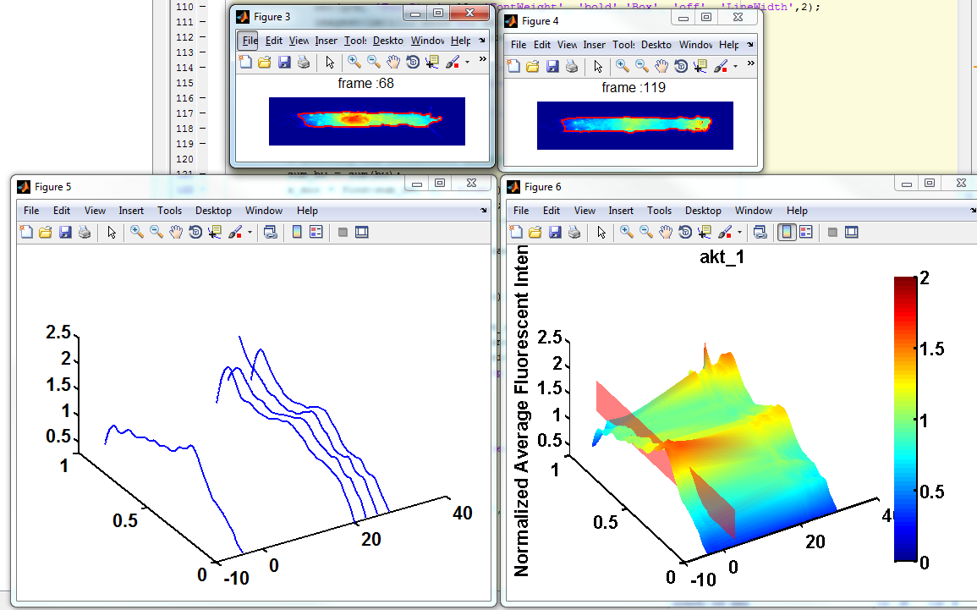
>> data = polarity_init_data(‘akt_1’);
>> single_cell_analyzer(‘akt_1’);
-> Track Cell and ROIs.

Slide 15
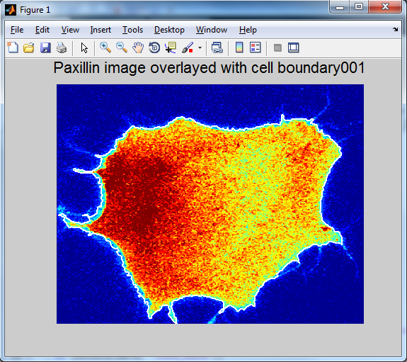
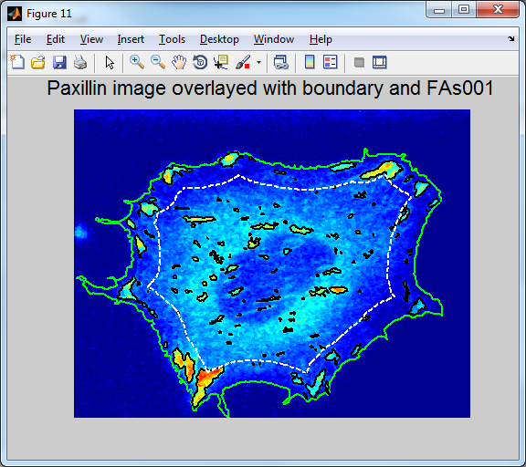
FA Detection and Subcellular Quantification
Detect Cell Masks
>> cell_name = 'src_pax';
>> data = sample_init_data(cell_name, 'batch_detect_cell');
>> batch_detect_cell(cell_name, data);
Detect Focal Adhesions
>> cell_name = 'src_pax';
>> data = sample_init_data(cell_name, 'batch_detect_fa');
>> batch_detect_fa(cell_name, data);

Slide 16
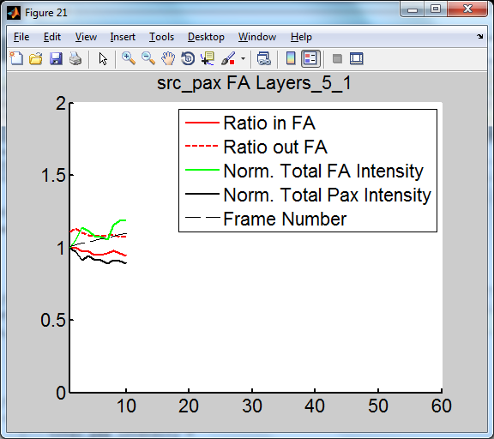
FA Detection and Subcellular Quantification
3. Programs to quantify local FRET ratio and FA intensity.
>> compute_fa_property(cell_name, data);

Slide 17
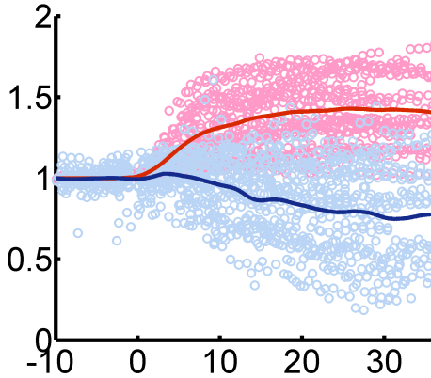
Putting Single Cell Data Together
Data
Average Curve
PDGF
Paxillin Intensity
Src FRET Ratio
Time (min)

Slide 18
Correlative FRET Imaging Microscopy (CFIM)
FRET imaging
Magnitude coupling
Quantitative molecular activity
Time
Linear regression
Phenotypic structures
Automated detection
Phenotypic change
Cross-correlation
Dynamic coupling

Slide 19
Diffusion Simulation and Single Cell Analysis
60000
0
Mesh
u1
u2
1000
Spatial Variasion
-1000
Temporal Variation
Estimated u_2
Difference between u_2 and estimated u_2
Axis 2000 vs 60000 for u’s
Improved resolution

Slide 20
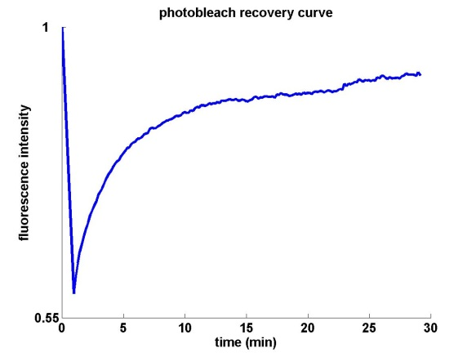
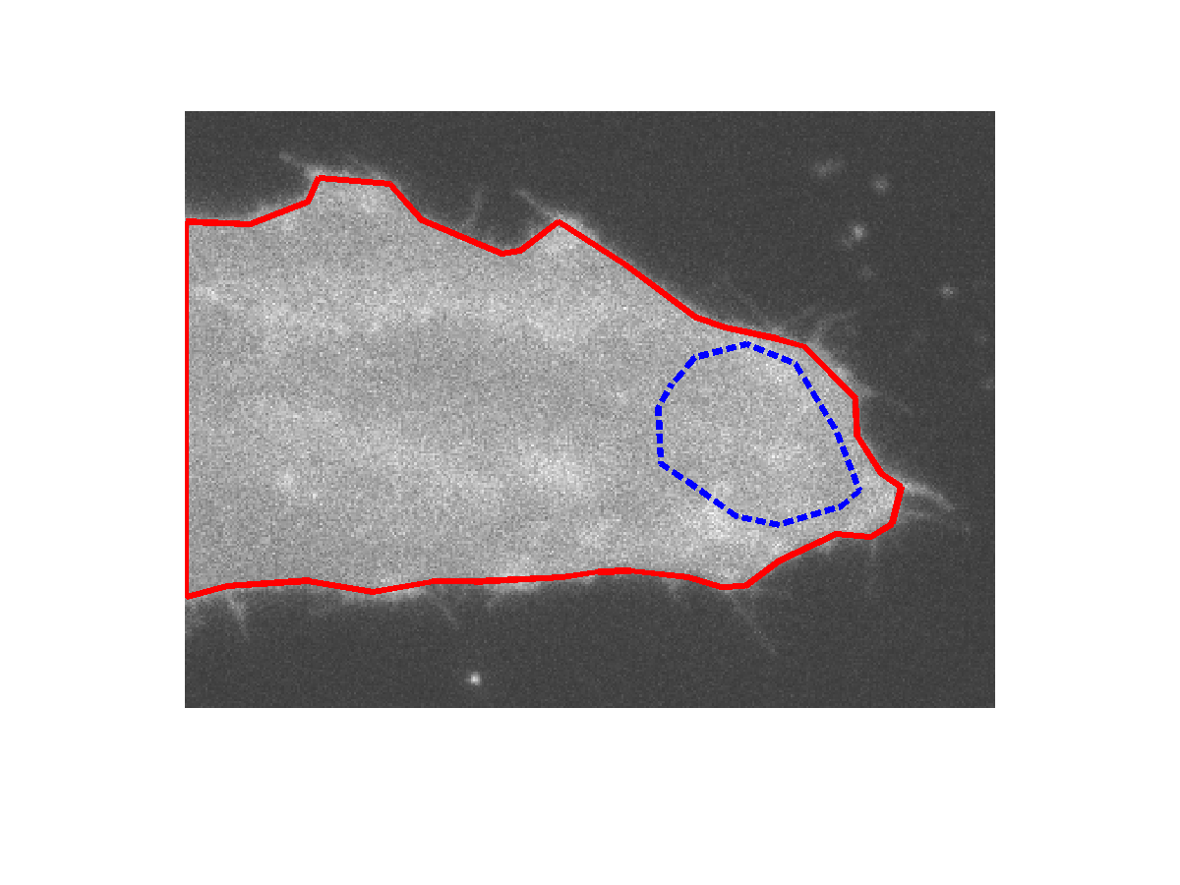
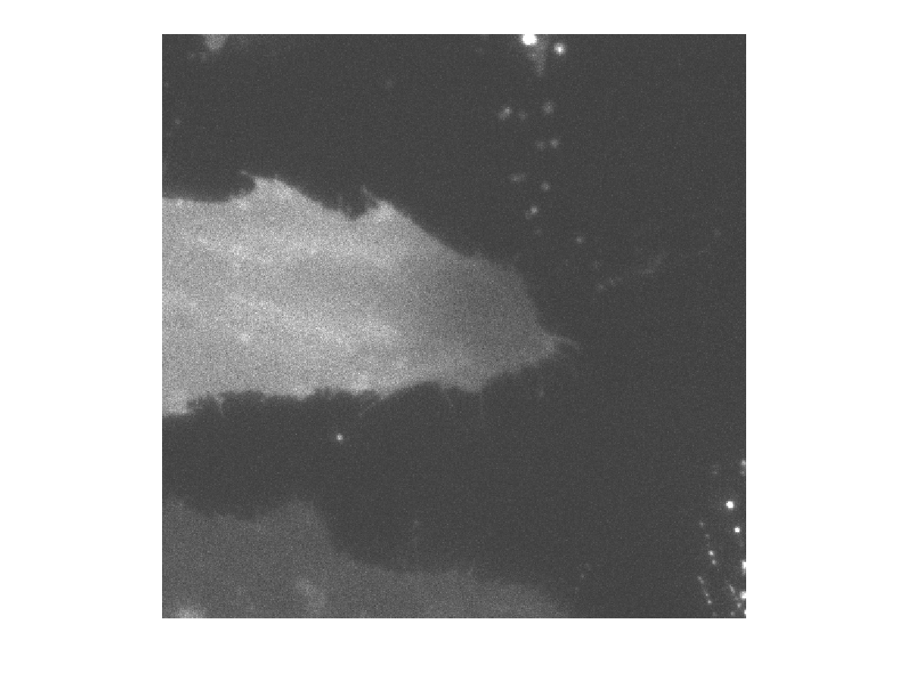
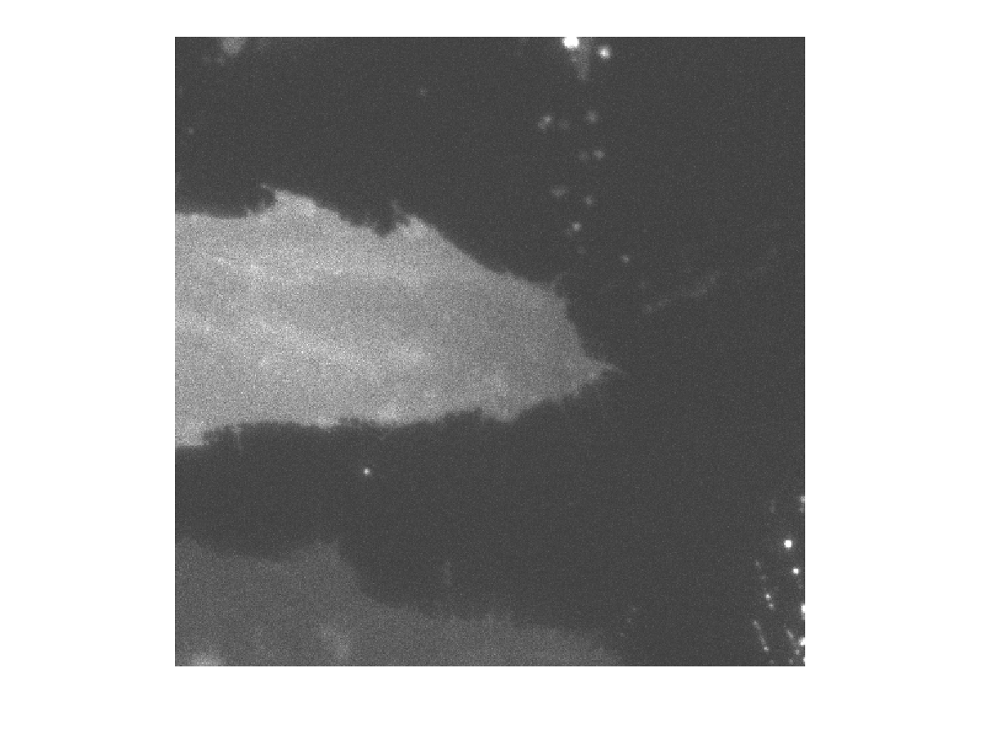
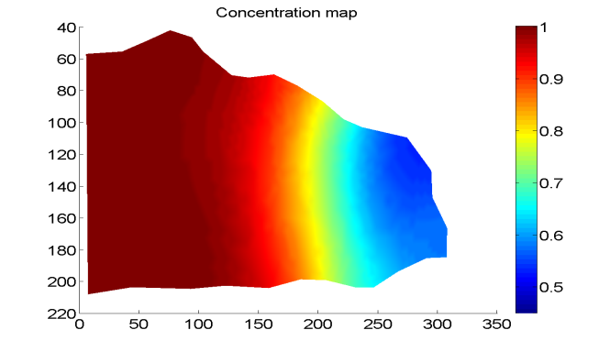
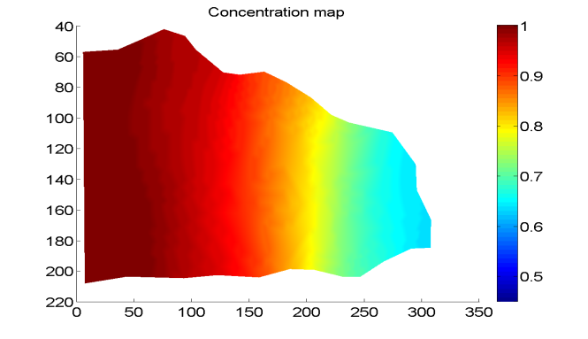
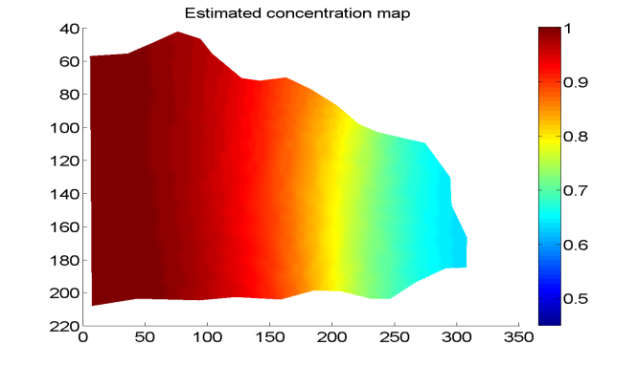
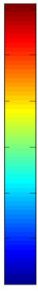
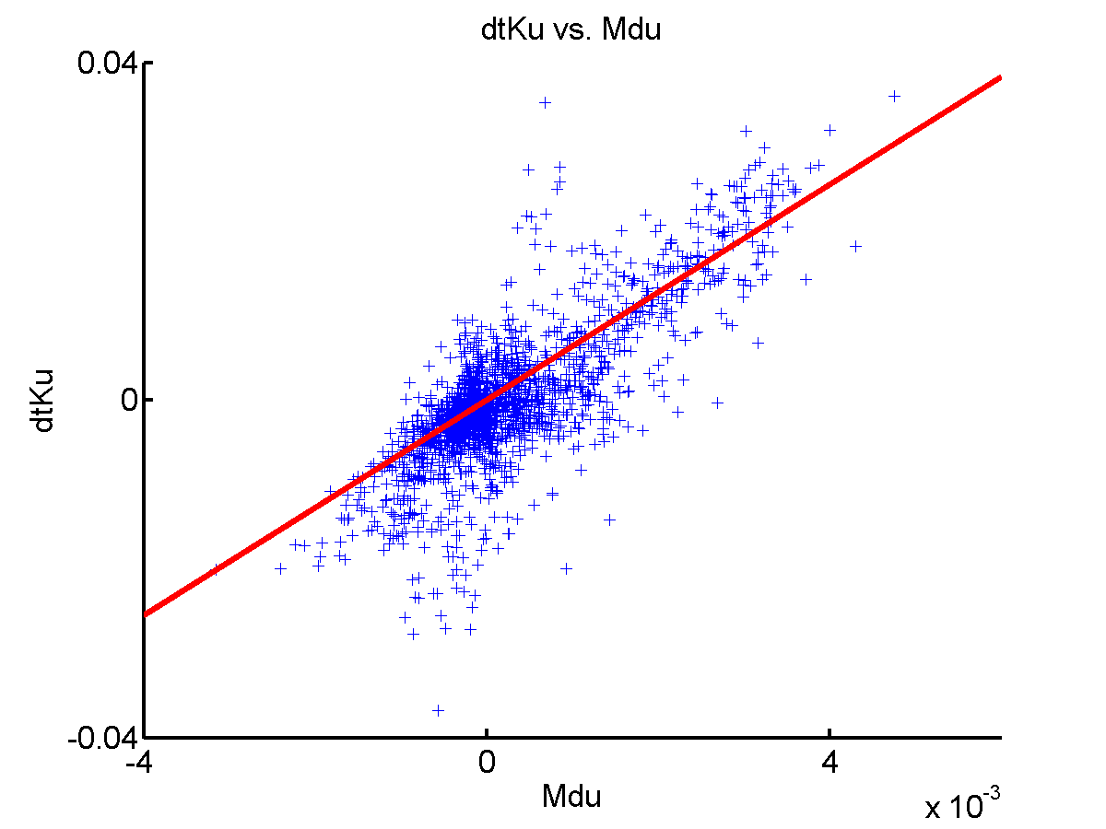
Comparison of Experimental and Simulated Results Biosensor Targeted at Lipid Rafts
photobleach
A
B
1
0 min
1 min
Normalized Intensity
4 μm
0.55
Time (min)
30
0
C
D
1
0.04
0
WDLC
0 min
Experiment
Simulation
0.45
-4e-3
0
4e-3
1 min
WCCT

Slide 21
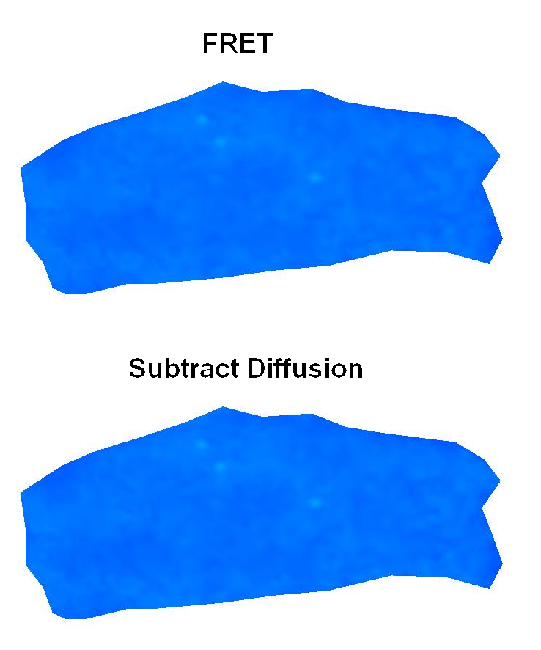
Subtraction of Diffusion in FRET Imaging
Lu S., et al. PLoS Computational Biology, 2008

Slide 22
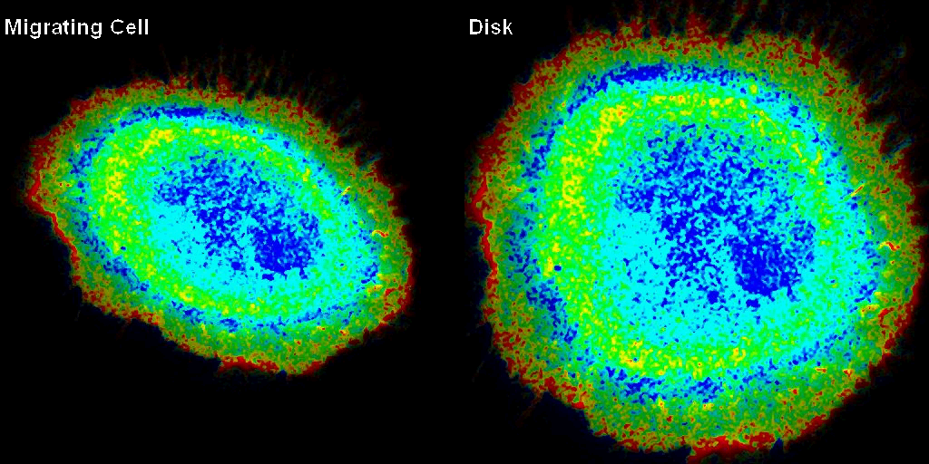
Map a Cell to a Unit Disk

Slide 23
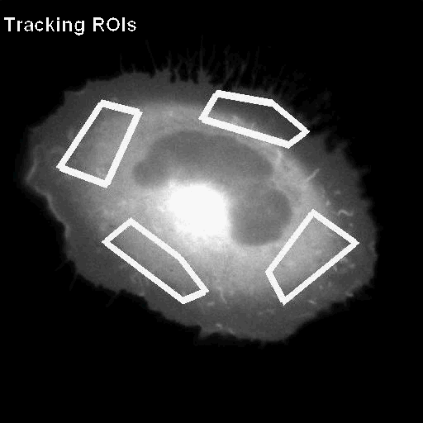
ROIs Tracked in a Migrating Cell

Slide 24
Other Useful functions/features
Image File Management
Openly available at google code: https://code.google.com/p/fluocell/
http://fluocell.blogspot.com/
Kathy Lu : kalu@ucsd.edu
Fluocel_4.2 coming up!
Future Developments
Users and Collaborations.
Improvement on Cell detection and feature detection.
Java Interface for Cross-Platform Compatibility.
???

Slide 25
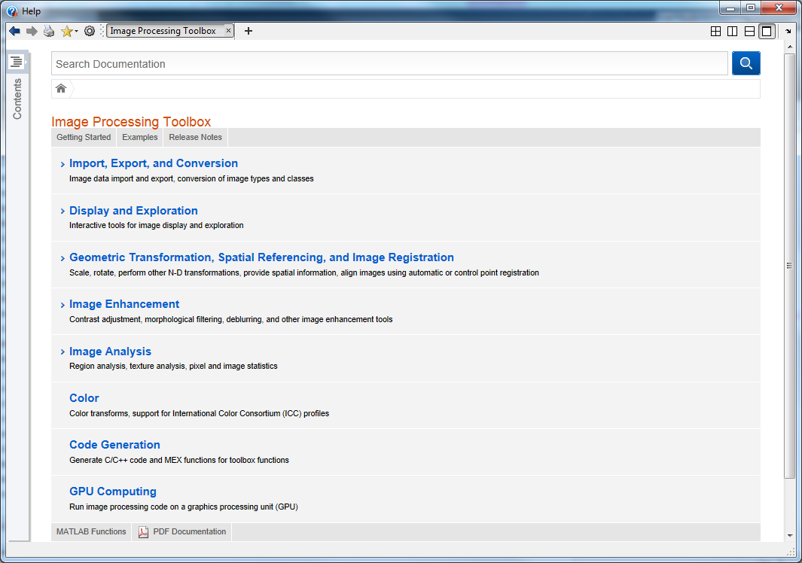
MATLAB Image Processing

Slide 26
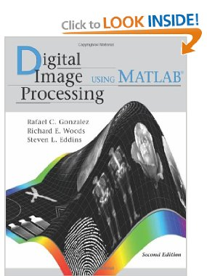
Digital Image Processing Using MATLAB

